Slide 1
Biodiversity & climate change
April Reside
april.reside1@jcu.edu.au

Slide 2
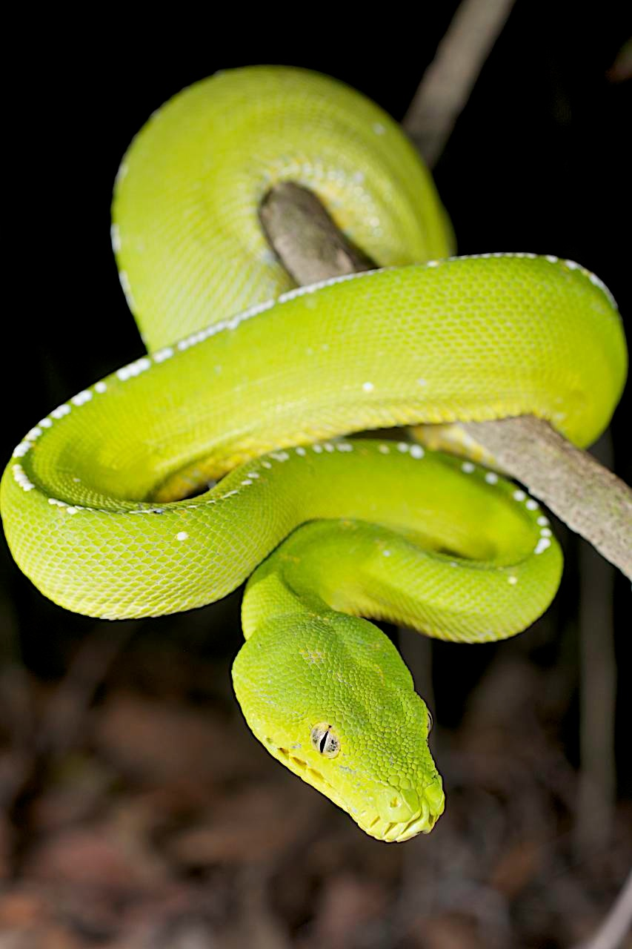
What do species require to adapt to climate change?
Suitable habitat now, future, and steps in between
→ Need to locate, protect & restore crucial areas
Stewart Macdonald

Slide 3
Incorporating carbon sequestration
Mitigation
Potential for carbon offset funding
→ Multiple objectives achieved

Slide 4
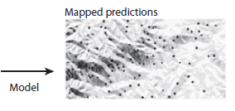
Predicting the location of future biodiversity hotspots
Climate
Temperature
seasonality
Species data from ALA
Project onto future environmental conditions
Future predictions
Future temperature
Adapted from: Elith & Leathwick 2009 Ann. Rev. Ecol. Evol. Syst.
Future rainfall

Slide 5
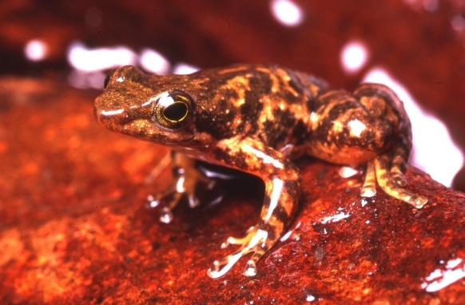
Species in Mackay-Whitsundays
30 frogs
261 bird
61 mammals
85 reptiles
= 437
Photo: Eric Vanderduys

Slide 6
Modelling protocol
Maxent
Current model
8 timesteps into the future (2015-2085)
Severe future scenarios (aka [GHG])
18 GCMs
1km grid cells
= lots of outputs (~1,043,136)

Slide 7
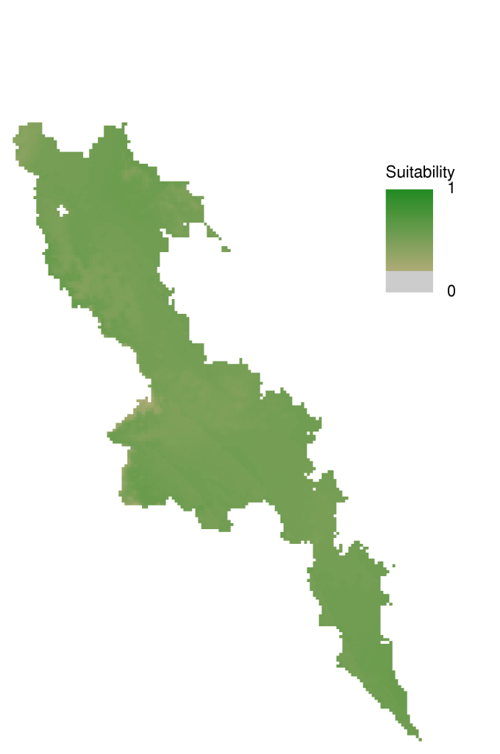
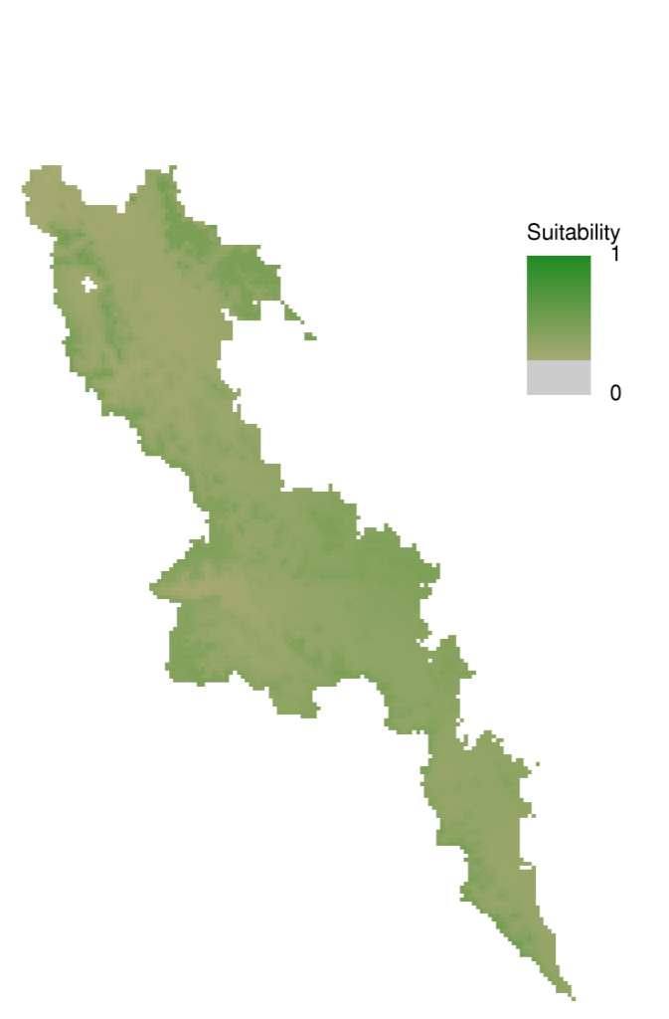
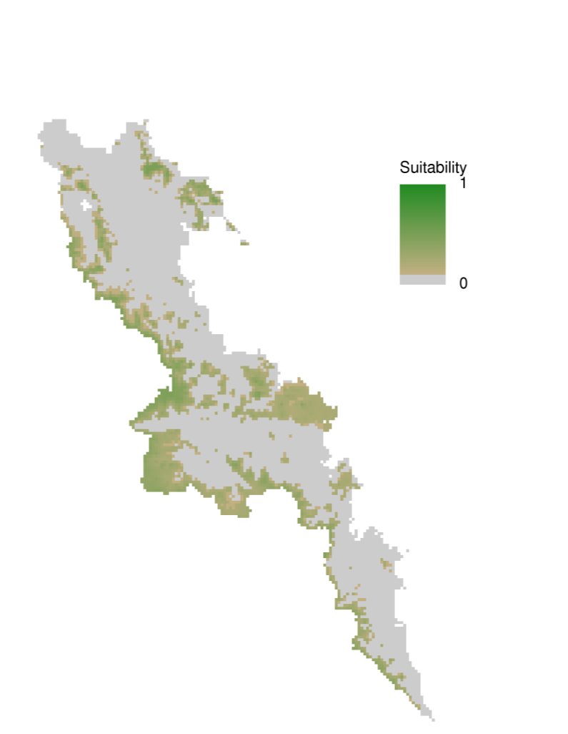
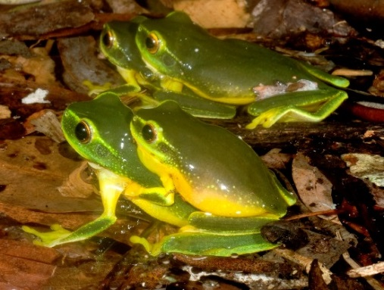
Litoria gracilenta
Current
2055
2085
Photo: Eric Vanderduys

Slide 8
Current
Current priorities

Slide 9
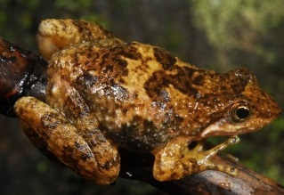
Species current
Connectivity between
Priority for species
Species future
Maximise both carbon & species
Uncertainty
potential carbon
Priority for carbon

Slide 10
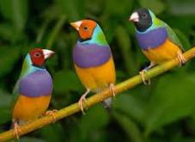
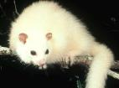
Landscape prioritisation
Find areas that compliment each other: not just with the most species, but important areas so that all species are included
weight endemic/restricted species higher
Include future climate change distributions, connectivity & species dispersal

Slide 11
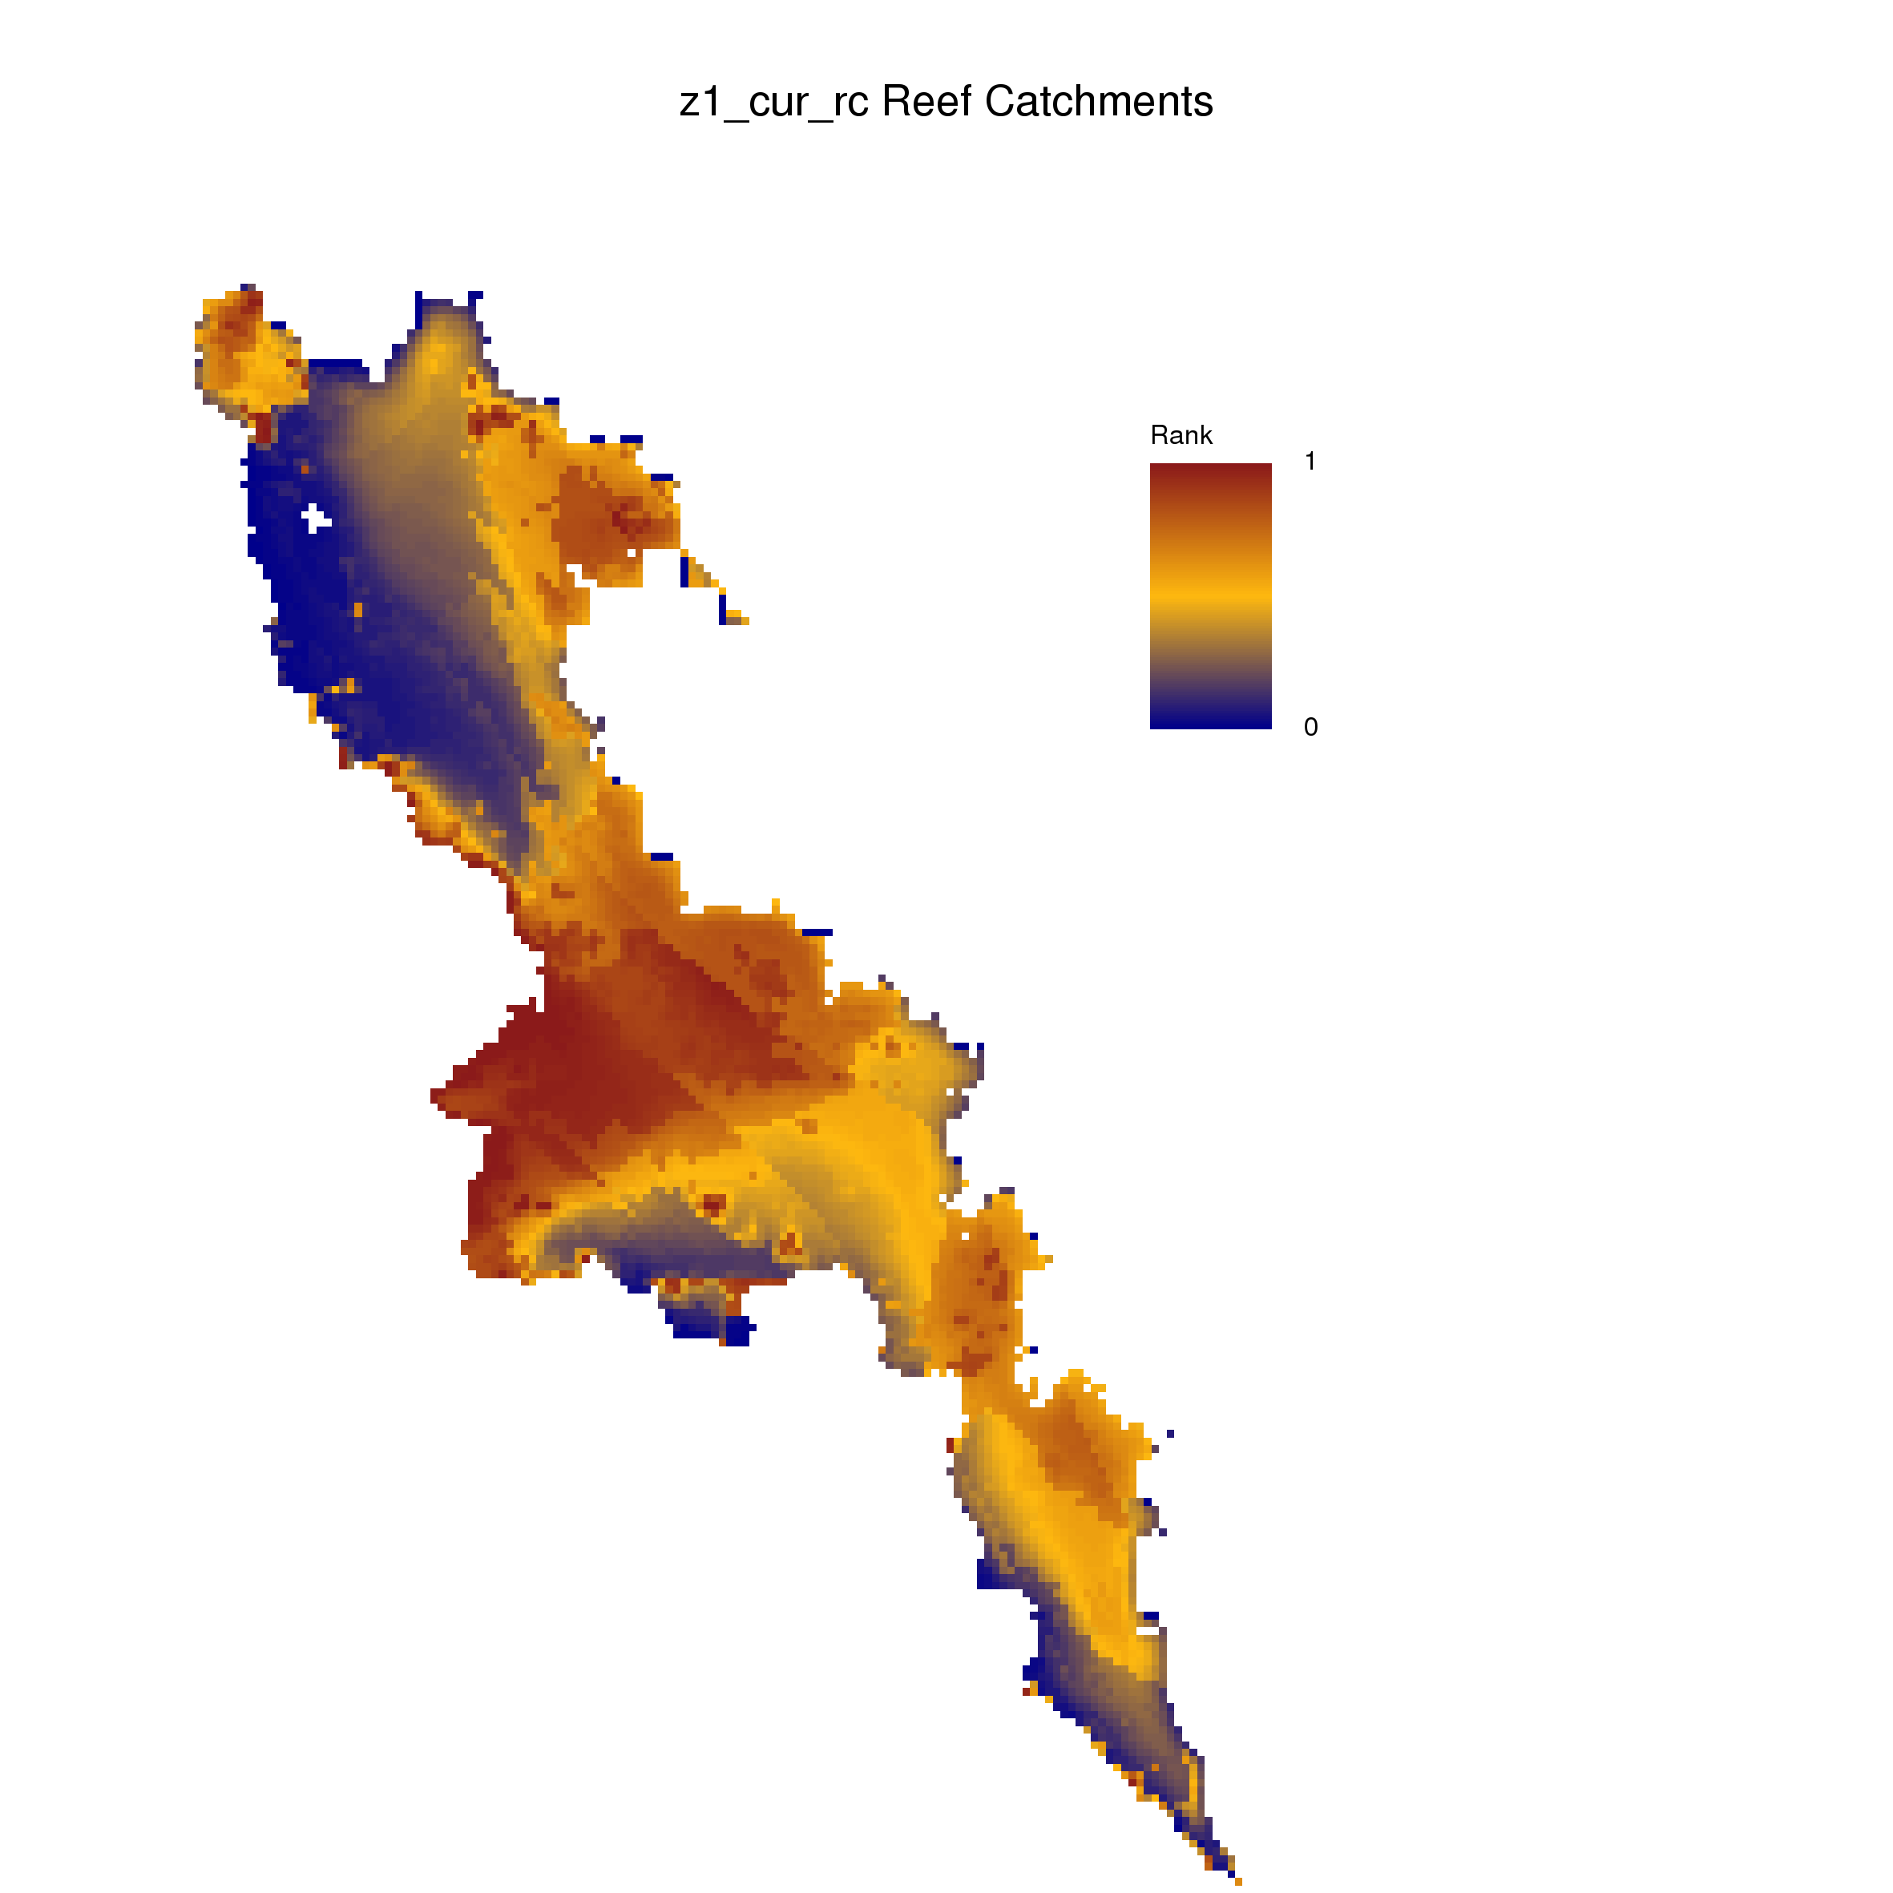
Current priorities

Slide 12
But we don’t know what the future will bring!
Incorporating uncertainty:
future areas will be down-weighted if the models disagree about their importance

Slide 13
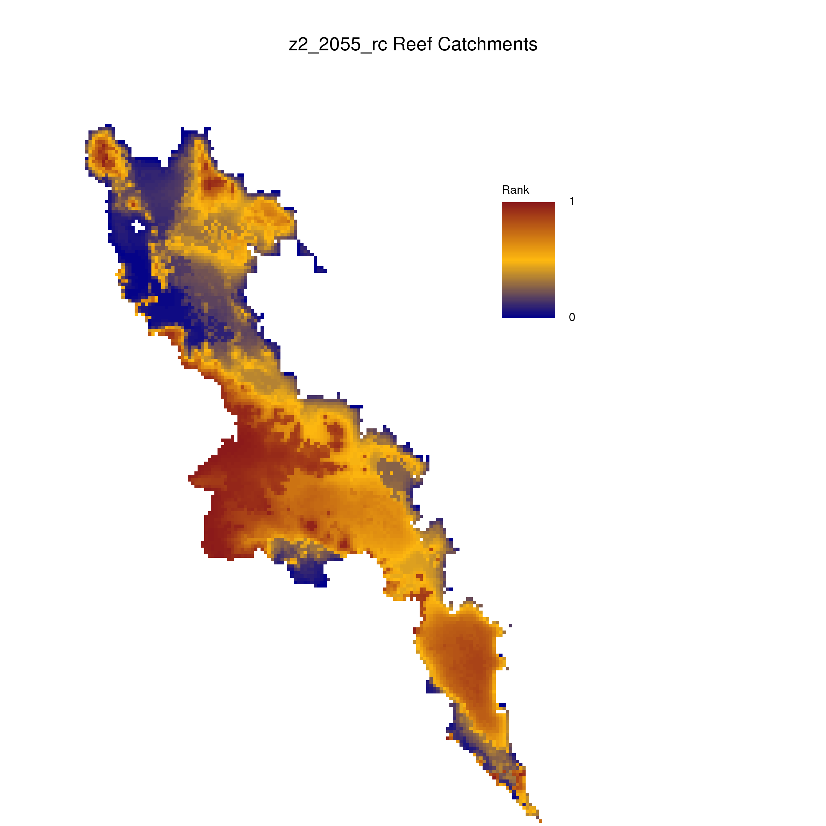
Current
2055

Slide 14
Current
2055
2085

Slide 15
Current + future
Incorporating several future time steps (2055 & 2085) priority areas for species and the areas that overlap with each
Find optimal solution for current & future biodiversity

Slide 16
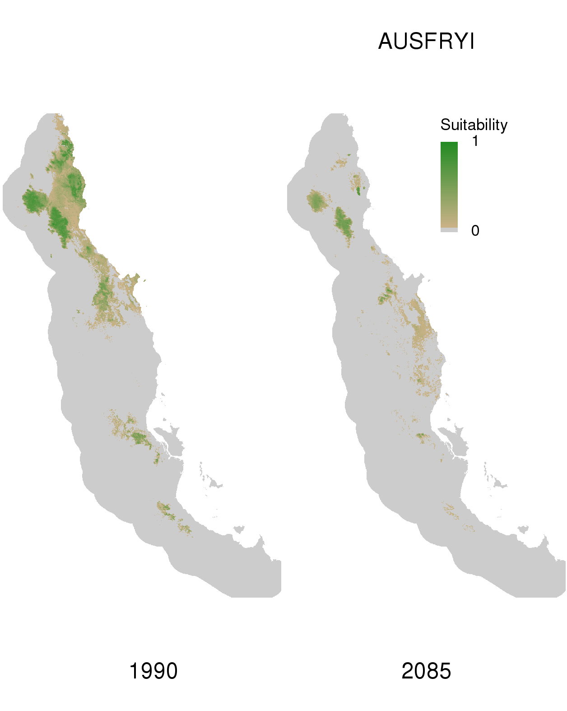
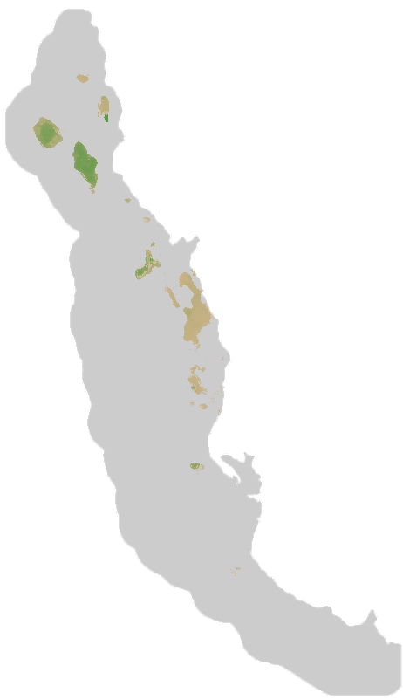
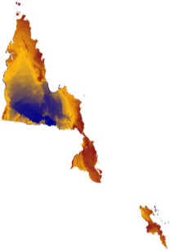
current 2055 2085

Slide 17
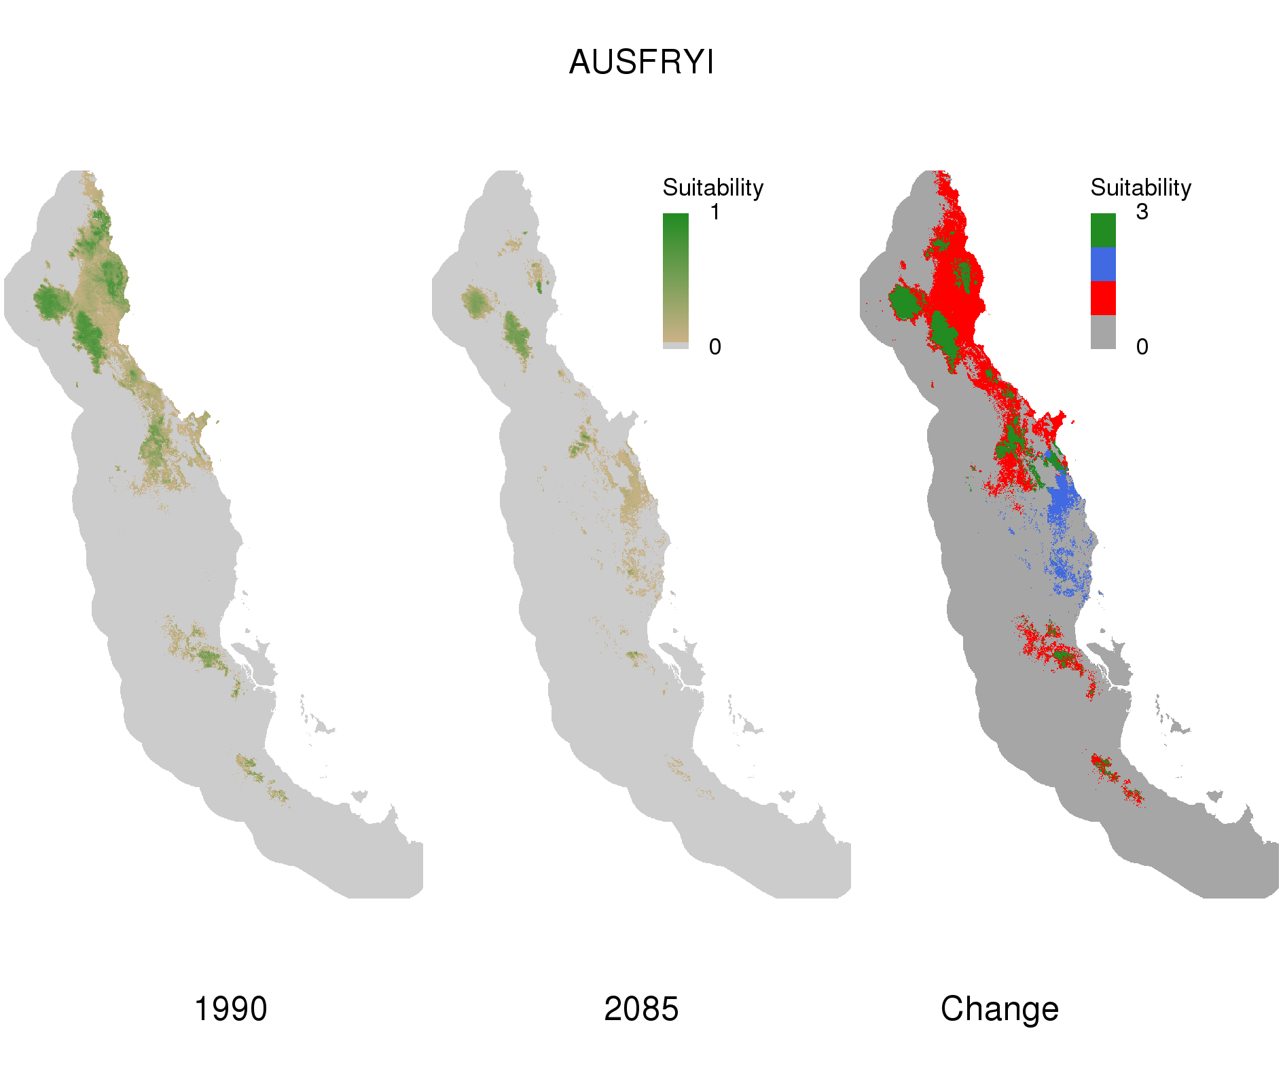
Current + Future
current 2055 2085
Change current - 2055

Slide 18
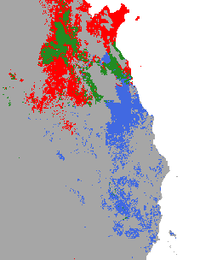
Current + Future
current 2055 2085
Change current - 2055

Slide 19
Connectivity from current to future
Calculate connectivity between the species current and future ranges:
current – 2055
2055 – 2085
→ higher priority if they’re suitable in the future AND they’re connected to current cells.

Slide 20
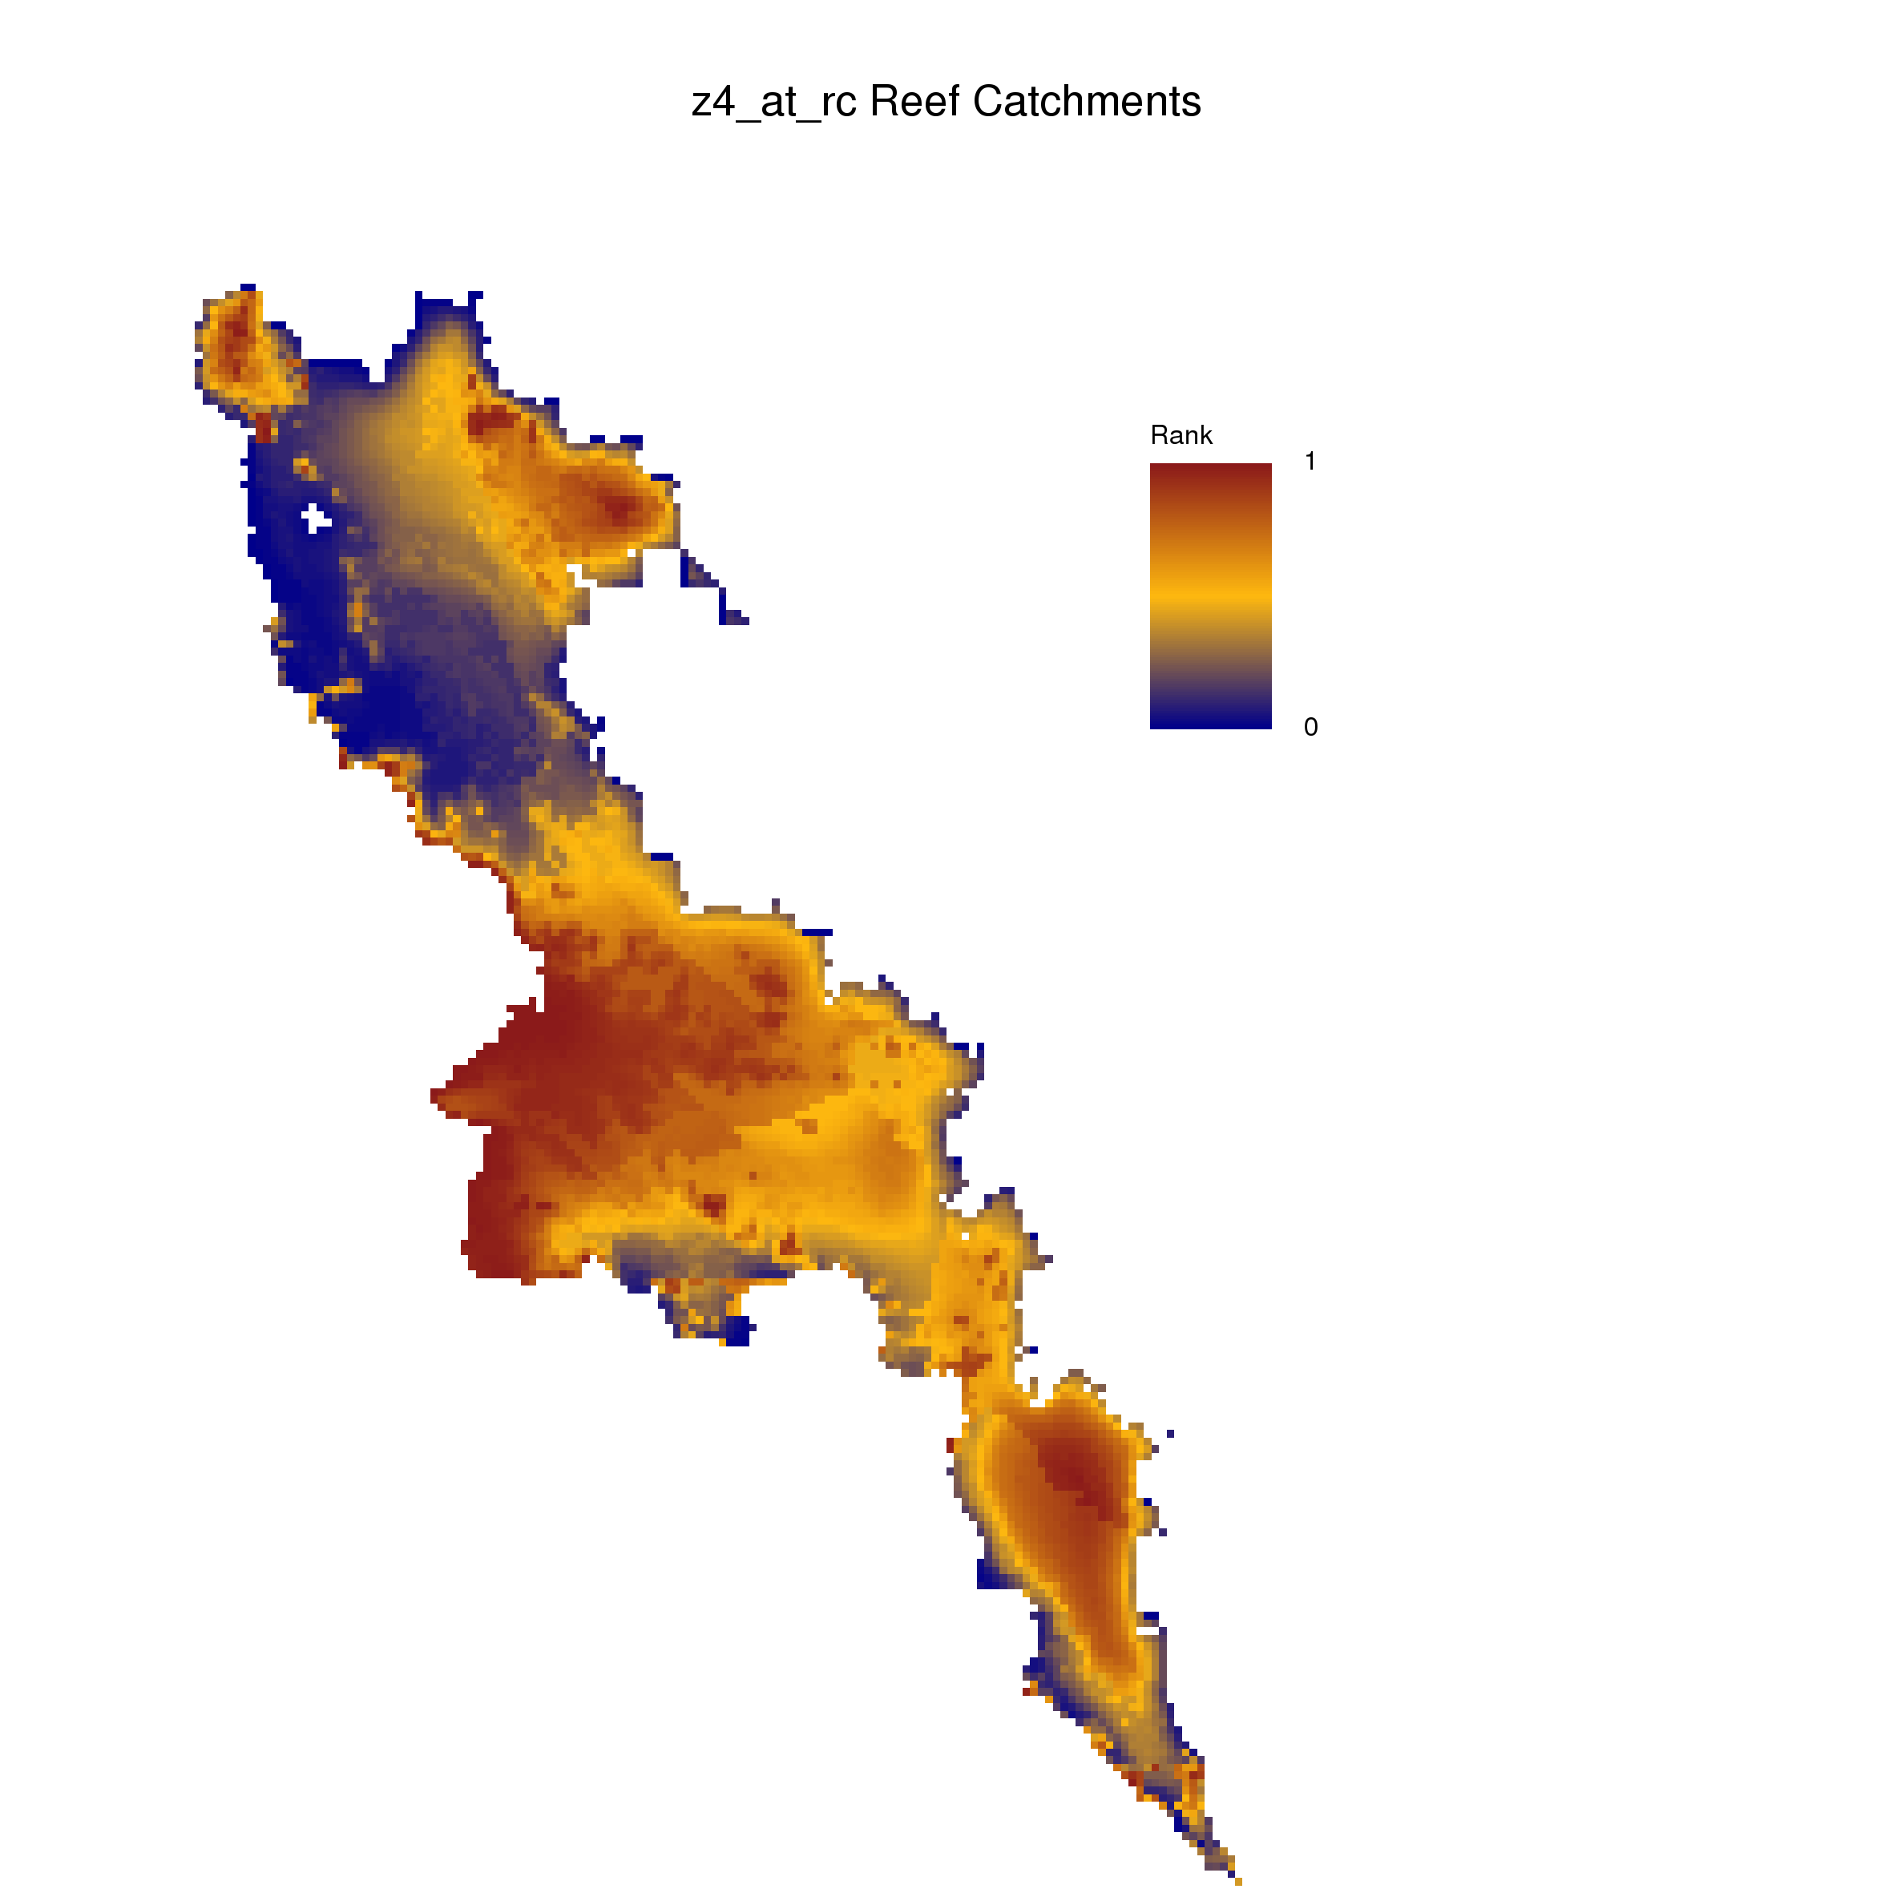
Current
2055
2085
All Time

Slide 22
What about carbon?

Slide 23
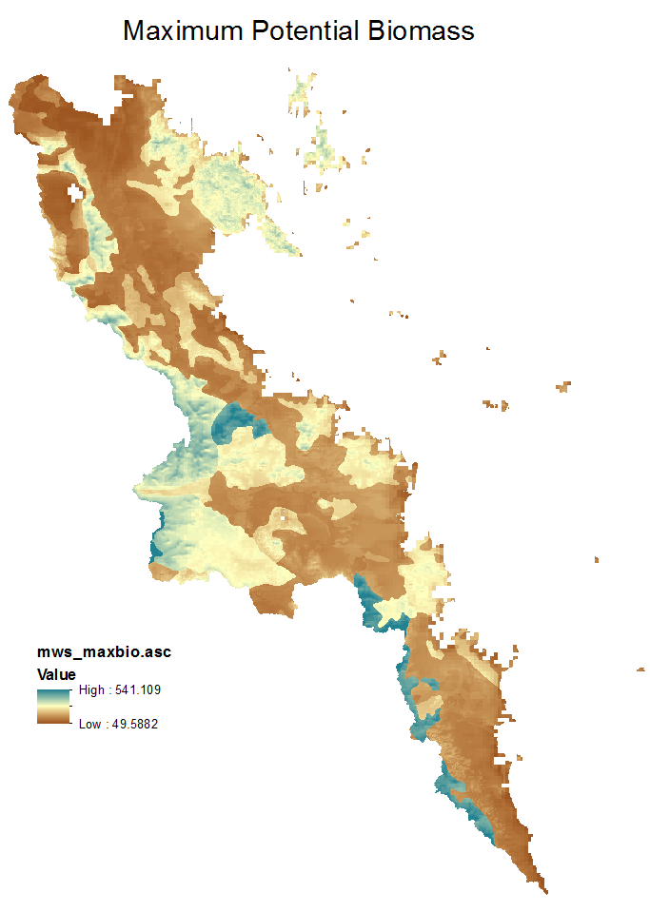

Slide 24
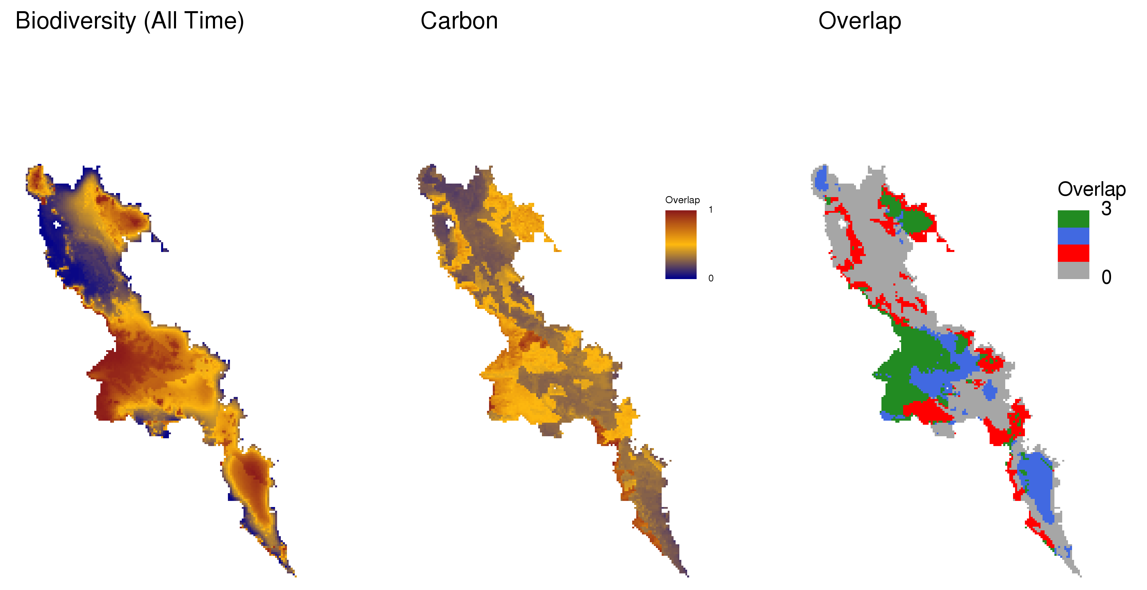
Neither
Carbon
Biodiversity
Both

Slide 25
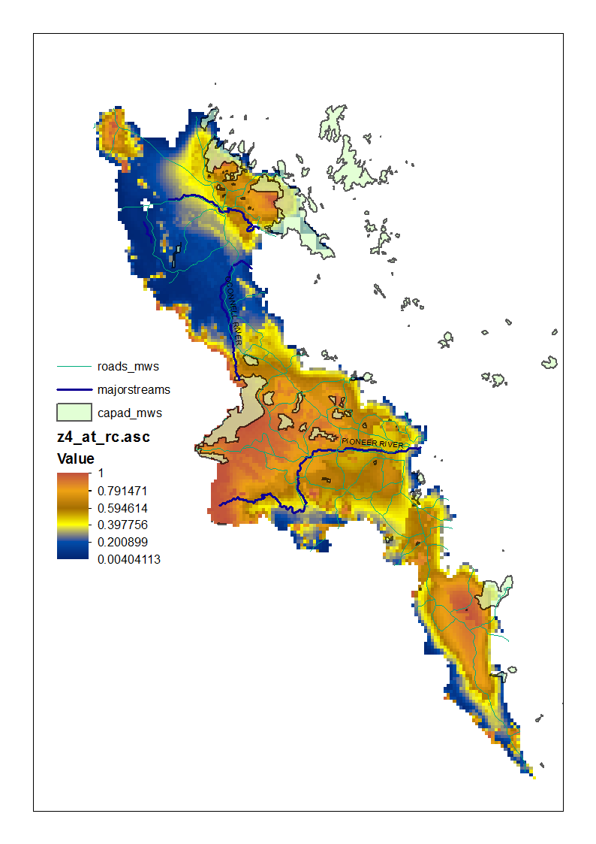
Dryander NP
Conway NP
Eungella NP
Mackay
Protected areas
Importance
Cape Palmerston NP

Slide 26
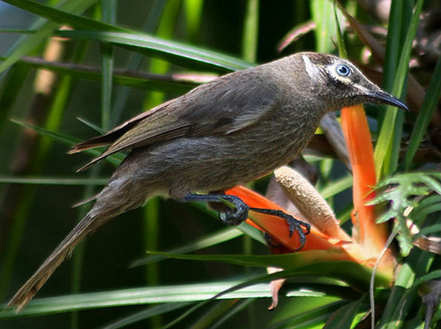
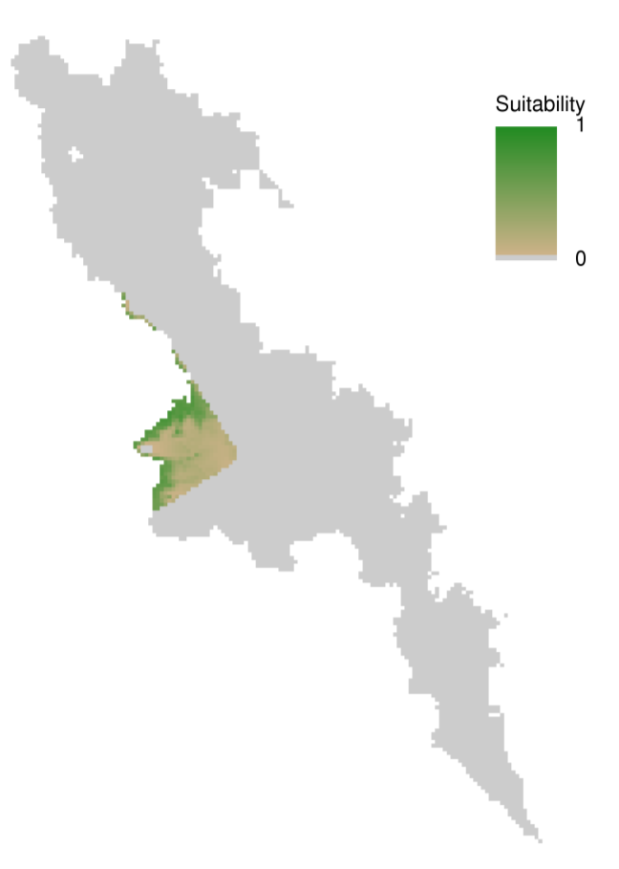
Eungella Honeyeater
Current

Slide 27
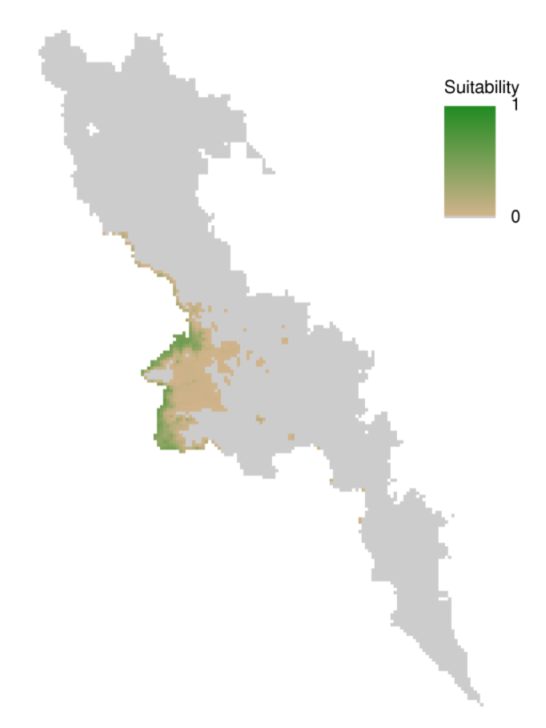
Eungella Honeyeater
Current
2055

Slide 28
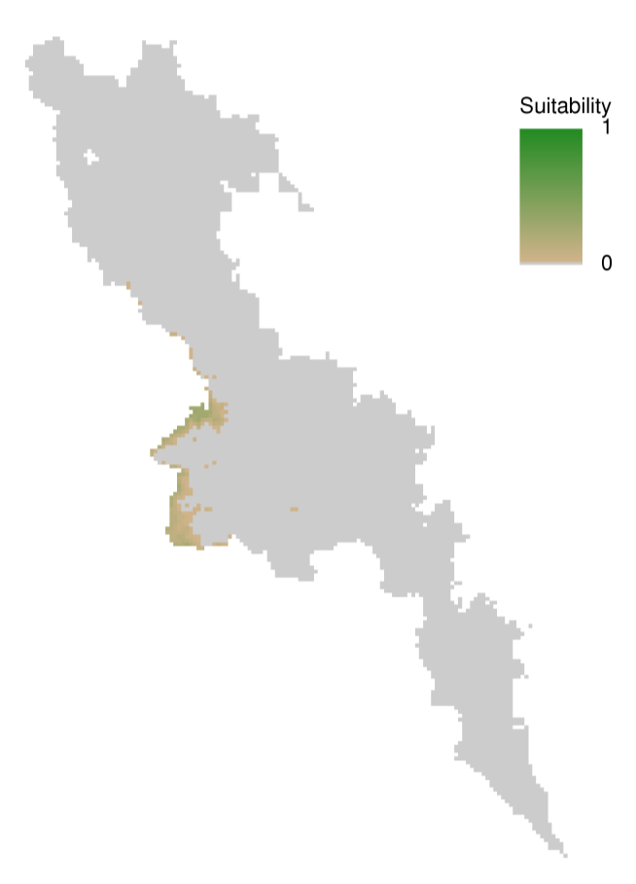
Eungella Honeyeater
Current
2055
2085

Slide 29
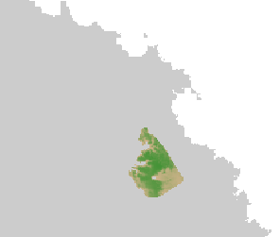
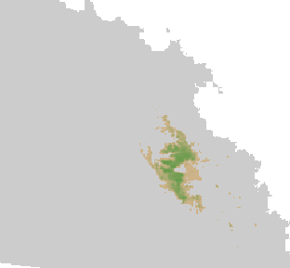
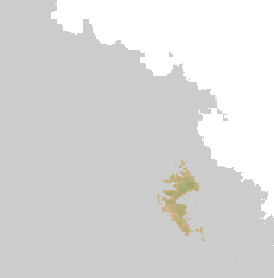
Eungella Honeyeater
Current
2055
2085

Slide 30
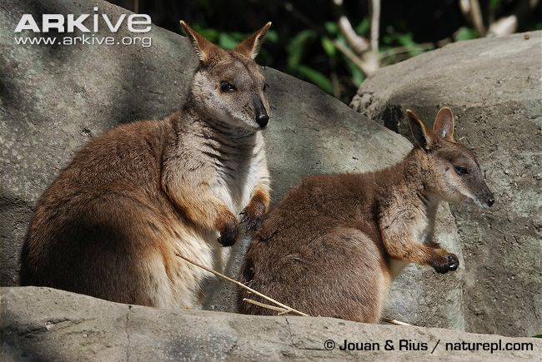
Proserpine Rock Wallaby
Current

Slide 31
Proserpine Rock Wallaby
Current
2055

Slide 32
Proserpine Rock Wallaby
Current
2055
2085

Slide 33
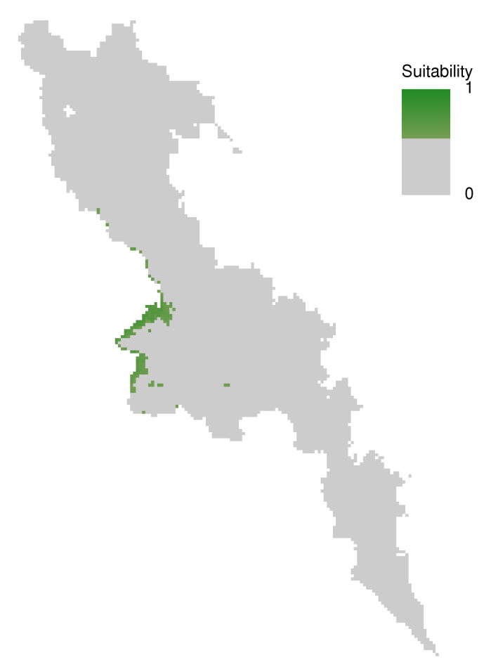
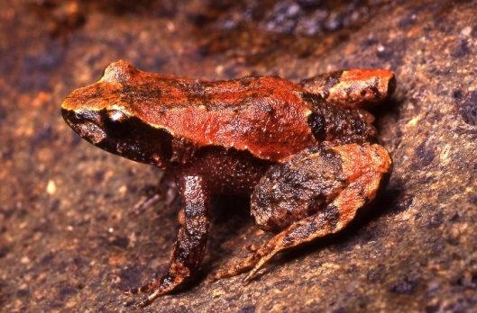
Taudactylus liemi
Current

Slide 34
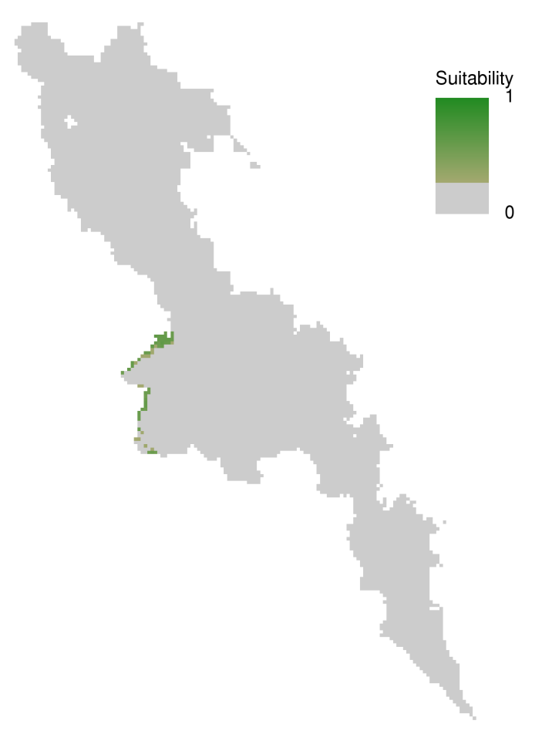
Taudactylus liemi
Current
2055

Slide 35
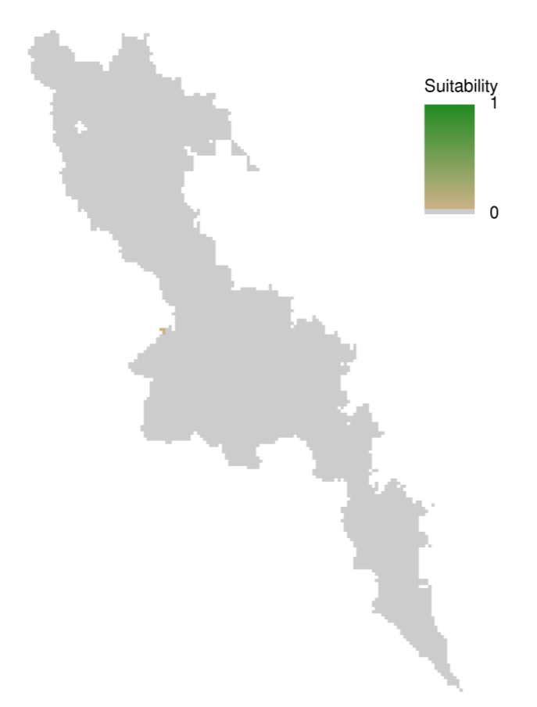
Taudactylus liemi
Current
2055
2085

Slide 36
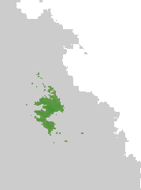
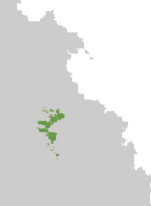
Taudactylus liemi
Current
2055
2085

Slide 37
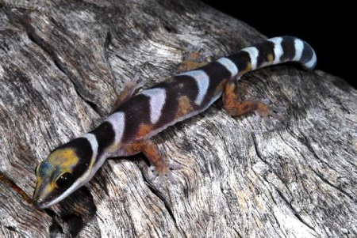
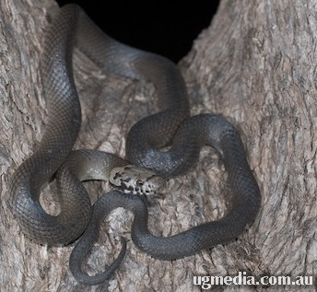
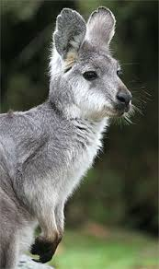
Species losing all climate space in future (modelled for RC)
Frogs
Cyclorana novaehollandiae
Litoria revelata
Mixophyes fasciolatus
Pseudophryne major
Uperoleia fusca
Uperoleia littlejohni
Birds
Chesnut teal
Western gerygone
Wonga pigeon
Rose robin
Striped honeyeater
Mammals
Wallaroo (Macropus robustus)
Reptiles
Cryptoblepharus pulcher
Eulamprus martini
Hoplocephalus bitorquatus
Hoplocephalus stephensii
Oedura castelnaui
Pogona barbata
Ramphotyphlops wiedii
Saproscincus czechurai

Slide 38
Acknowledgements
Bob Pressey, Steve Turton, Jeremy VanDerWal, Erin Graham, Cath Moran, Cassie James

