Slide 1
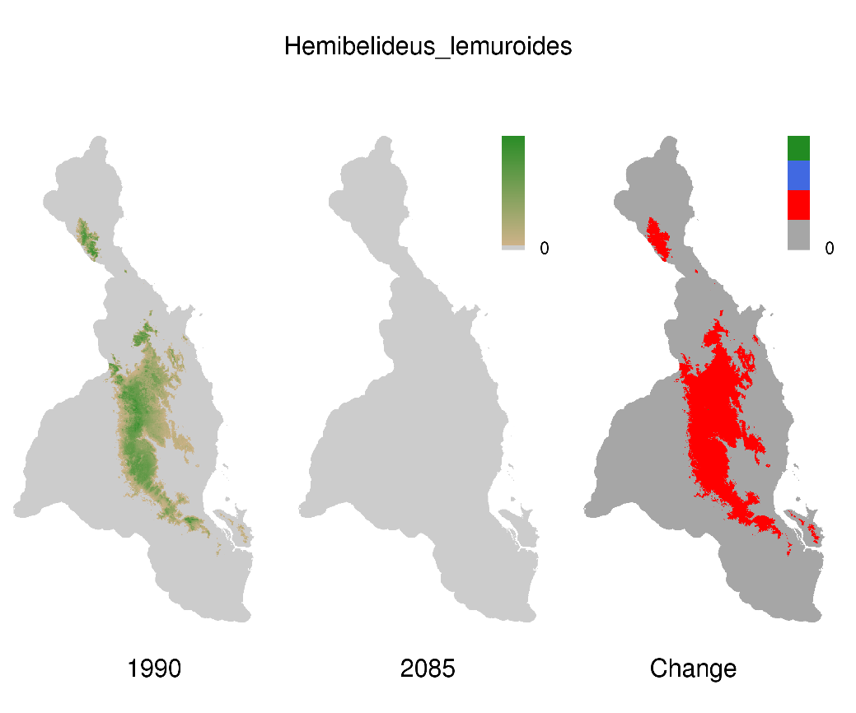
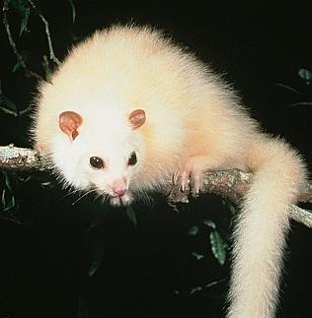
Climate space for the Lemuroid Ringtail Possum
always suitable
becomes suitable
becomes unsuitable

Slide 2
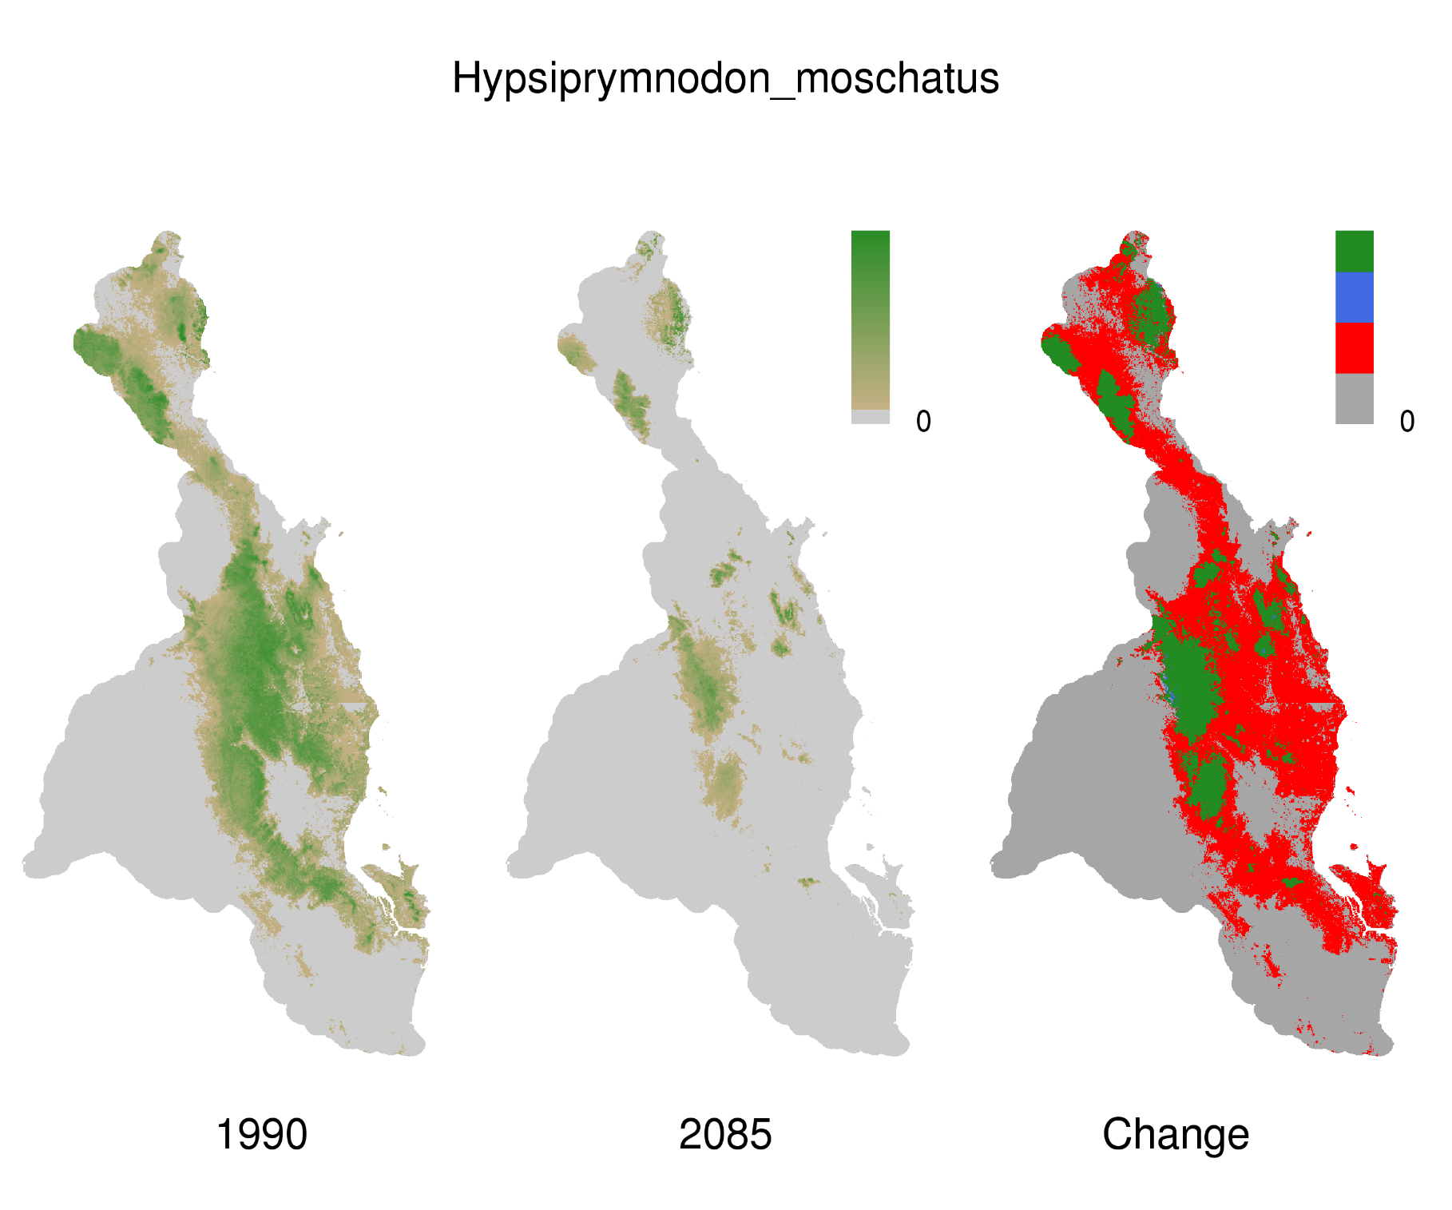
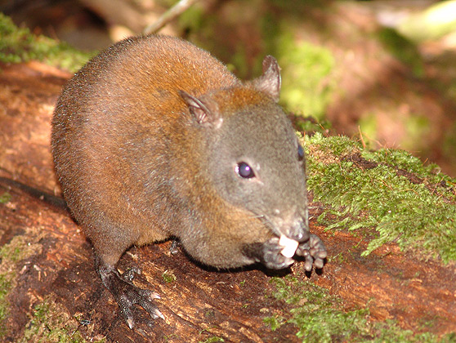
Climate space for the Musky Rat Kangaroo
always suitable
becomes suitable
becomes unsuitable

Slide 3
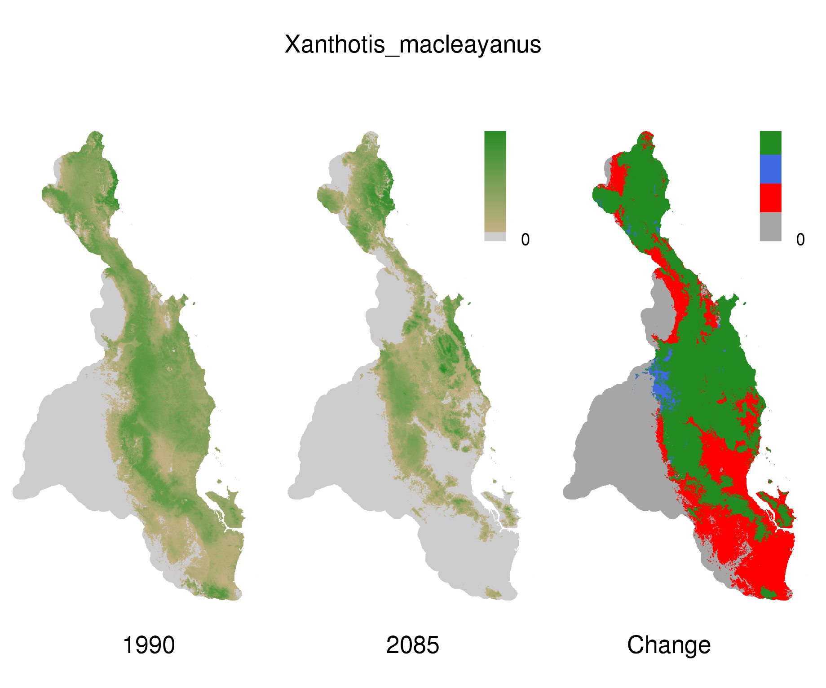
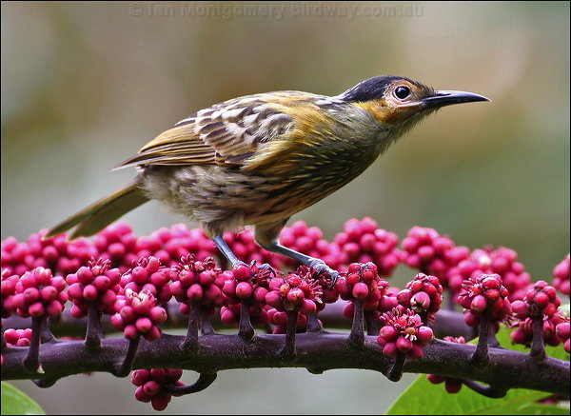
Climate space for the Macleays Honeyeater
always suitable
becomes suitable
becomes unsuitable

Slide 4
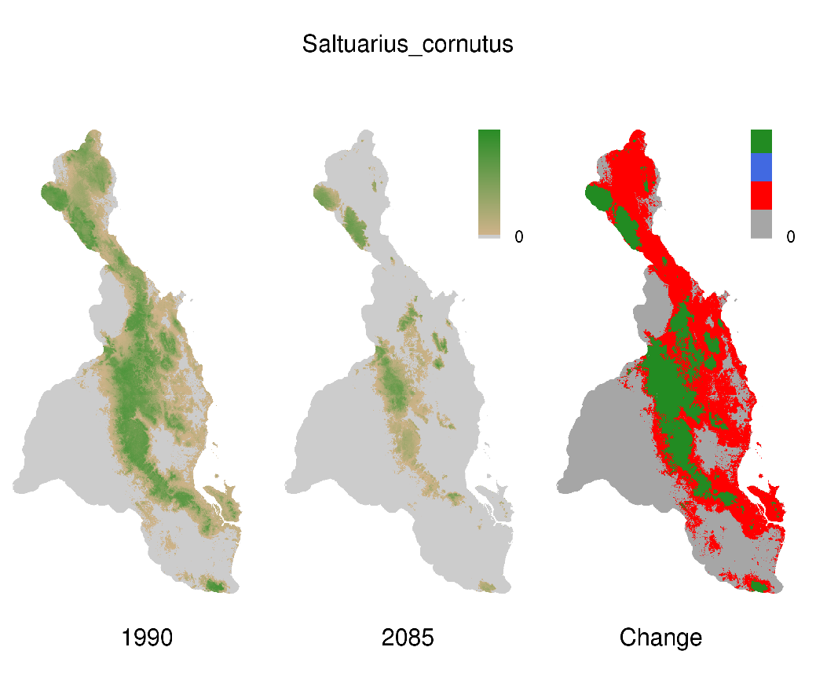
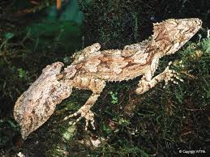
Climate space for the Northern Leaf Tailed Gecko
always suitable
becomes suitable
becomes unsuitable

Slide 5
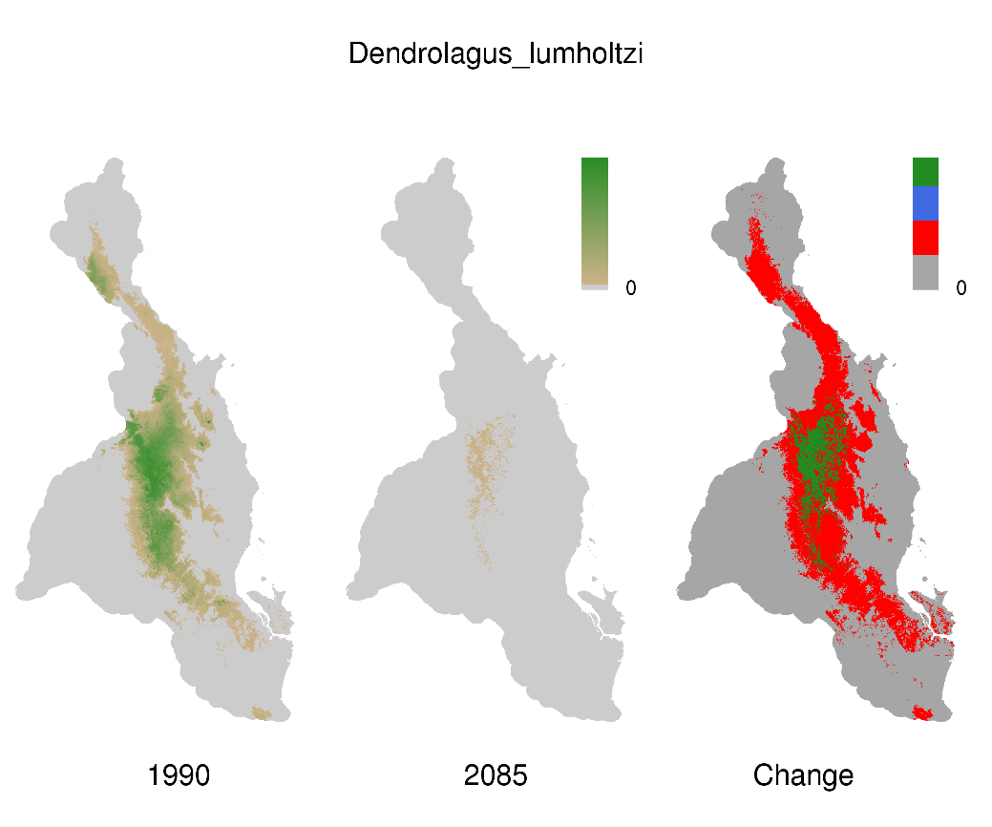
Climate space for the Lumholtz Tree Kangaroo
always suitable
becomes suitable
becomes unsuitable
Photo: Tree Kangaroo and Mammal Group
www.tree-kangaroo.net

Slide 6
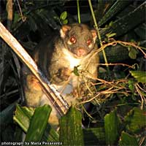
Climate space for the Green Ringtail Possum
always suitable
becomes suitable
becomes unsuitable
Photo courtesy of Tree Kangaroo and Mammal Group
www.tree-kangaroo.net

Slide 7
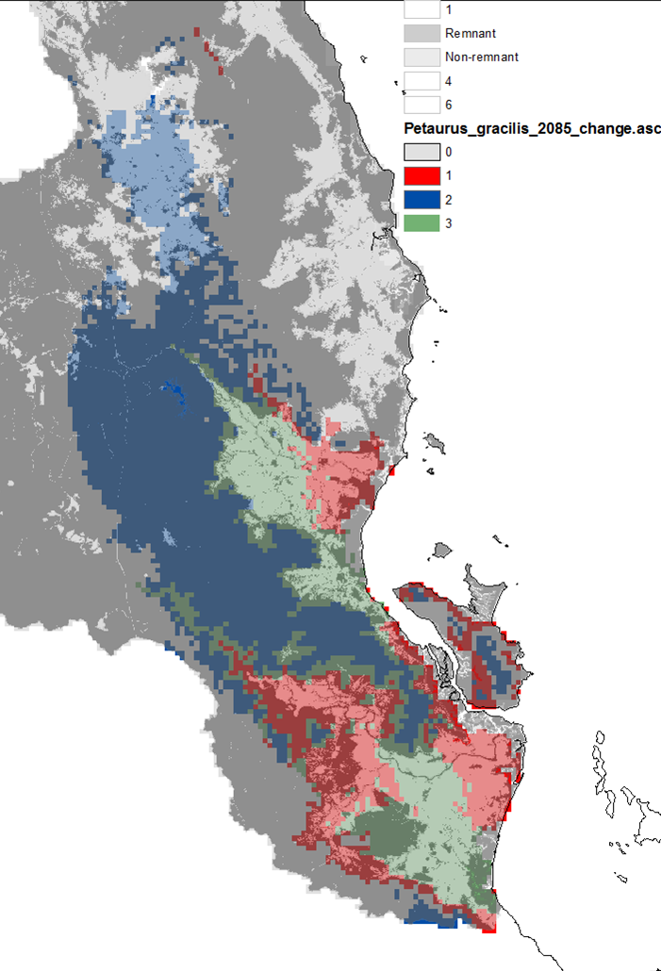
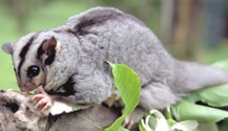
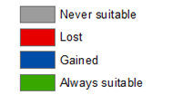
Mahogany Glider
(Petaurus gracilis)
Habitat: restricted to a narrow band of swampy, lowland forest.
Climate change vulnerability: more climate space gained than last. “always suitable” areas are mostly non-remnant; a large proportion of the gained climate space is remnant. The gained areas are mostly high altitude. Some area gained in MWS.
Spatial management actions:
Prioritise protection for areas that remain suitable.
Protect upland areas of gained climate space.
Consider translocation to gained climate space, in AWT, MWS or Hinchinbrook Island.

